Slide 1

Amazon Sales Analysis

Slide 2
Introduction
Welcome!
In this presentation, we will delve into the sales management landscape of Amazon, leveraging data analytics to uncover trends, key metrics, and meaningful relationships between various attributes. This comprehensive analysis aims to enhance our understanding of sales performance, reduce costs, and maximize profits.

Slide 3
Problem Statement
Title: The Challenge of Effective Sales Management
Sales management has gained importance to meet increasing competition and the need for improved methods of distribution to reduce cost and increase profits.
Sales management today is the most important function in a commercial and business enterprise
Do ETL some Amazon dataset and find for me Sales Trend -> month-wise, year-wise, yearly-month-wise
Find key metrics and factors and show meaningful relationships between attributes

Slide 4
Tools & Techniques Used
Data Source: Amazon Sales Dataset
ETL Process:
Extract: Data extraction from Amazon sales records
Transform: Data cleaning, normalization, and transformation using Power Query
Load: Loading transformed data into Power BI for analysis
Data Visualization: Power BI Dashboard
Analysis Techniques:
Trend Analysis
Key Metrics Evaluation
Time Series Analysis

Slide 5
Main KPIs
Total Revenue: This KPI shows the addition of total revenue of entire dataset
Total Profit: This KPI shows the addition of total profit of entire dataset
Total Quantity Sold: This KPI shows how many units sold
% Profit: This KPI shows overall profit percentage

Slide 6
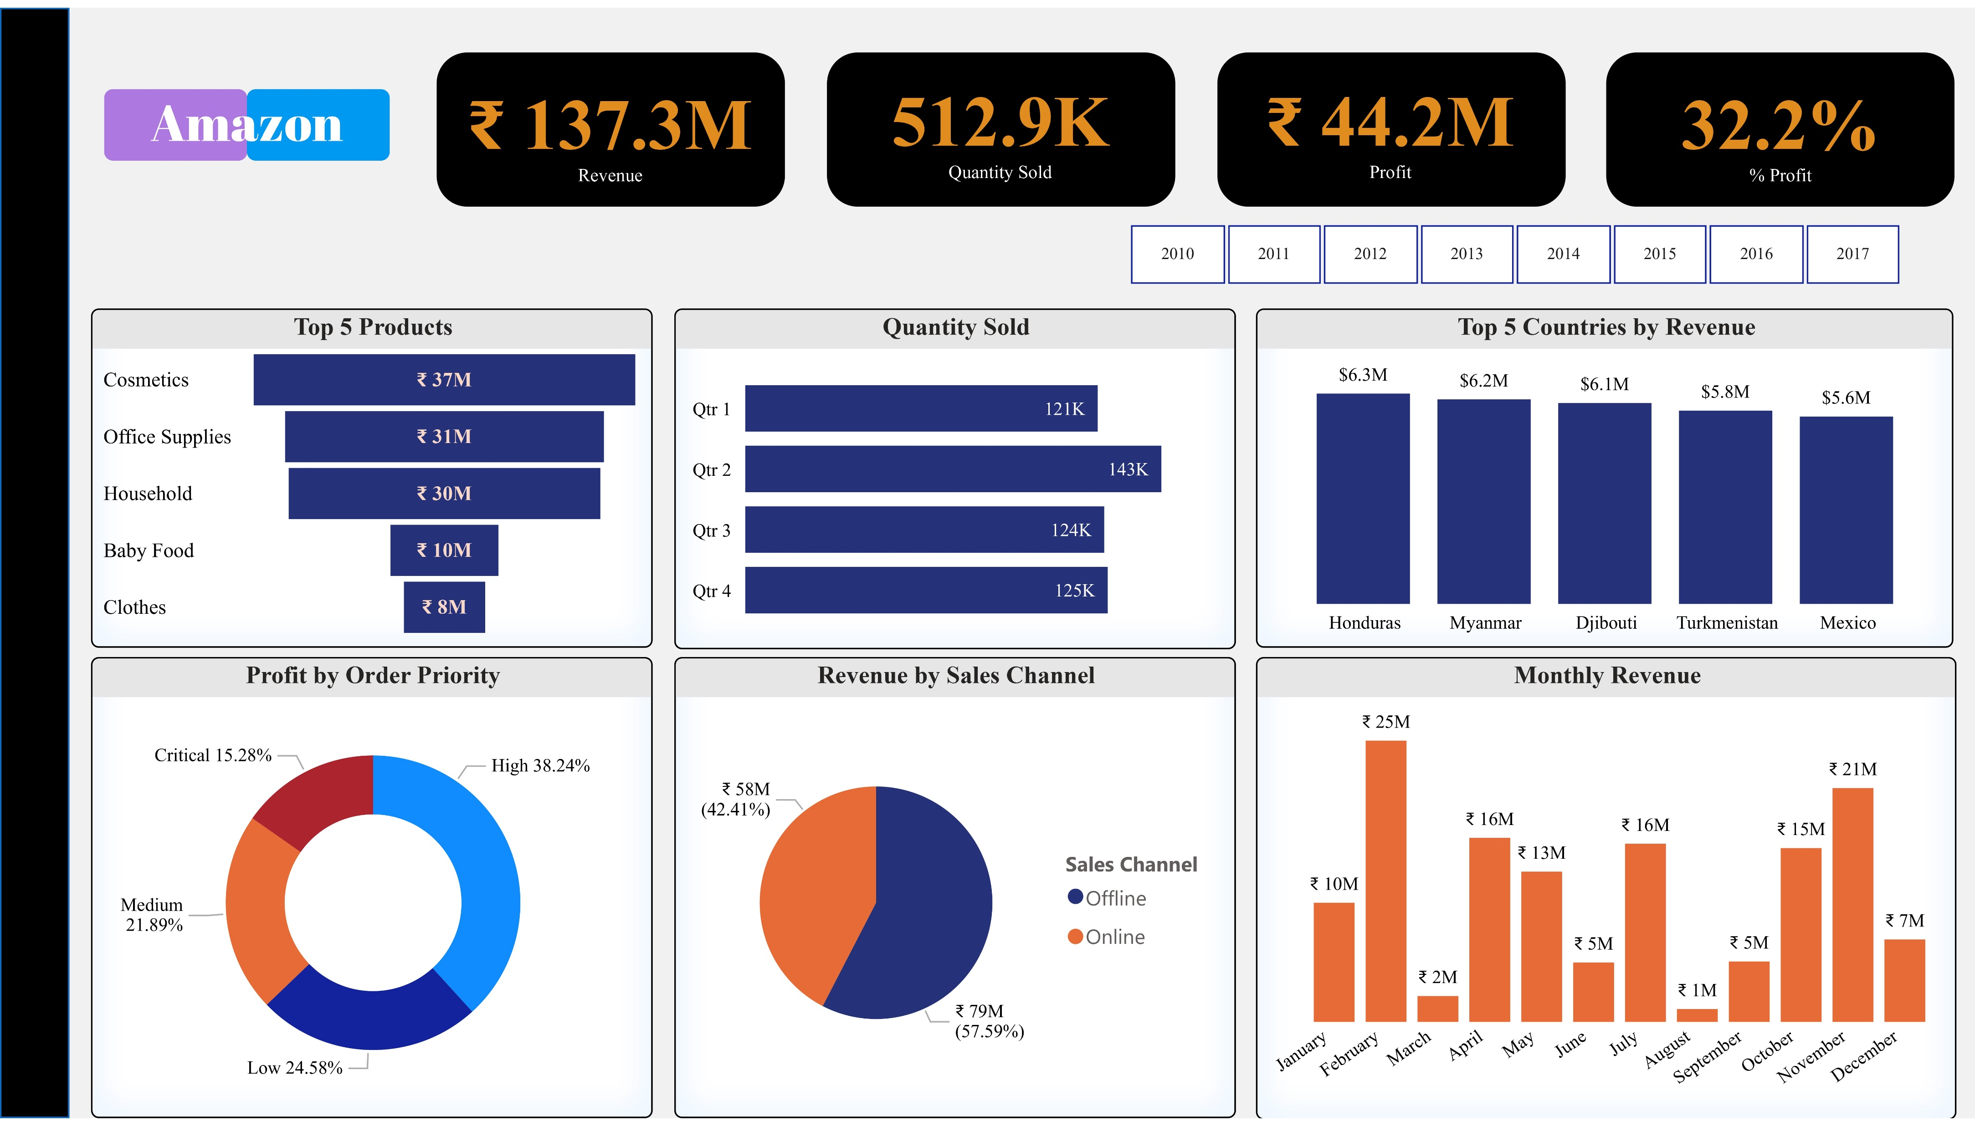

Slide 7
Insights
The Amazon Sales Dashboard provides insights into sales performance across various metrics. Here are some key takeaways:
Revenue by Country: Honduras is the top country in terms of revenue (6.3M).
Revenue by Sales Channel: Online sales accounts for 42.41% of total revenue, while offline sales account for 57.59%.
Profit by Order Priority: High priority orders contributes to (16.89M) followed by low priority (10.86M).
Top 5 Products by Revenue: Cosmetics is in 1st place by contributing (37M) followed by Office Supplies (31M)
Overall, the dashboard suggests that online sales and the high-priority orders are driving the most revenue for Amazon.

